Slide 1
Rules of Origin, Origins of Terms, and Terms of Trade
Alan V. Deardorff
University of Michigan
Lunch talk at Yale
March 29, 2016

Slide 2
Rules of Origin of Terms of Trade
Three topics from my recent (?) work:
How Rules of Origin can hurt
Intro to Glossary
Origins of a few terms in my Glossary
Including the “Terms of Trade”

Slide 3
Rue the ROOs

Slide 4
Rue the ROOs
Example of how ubiquitous FTAs can be worse then none
3 countries, each with same amount of labor
3 industries (but 6 goods)
Goods demanded in the same fixed proportions (X=Y=Z) in each country
Each industry has separate input & output
Constant labor requirements (a la Ricardo)
differing symmetrically across countries and industries

Slide 5
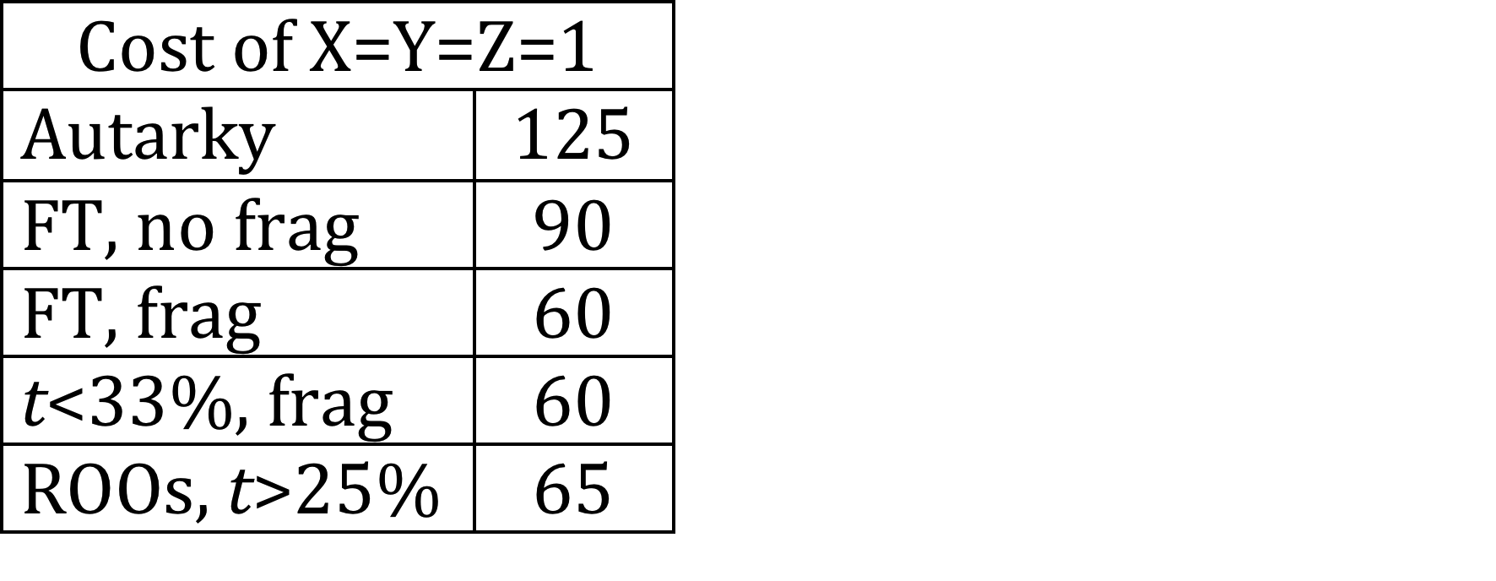
Example 2
Example
Country A |  |  |  |  | Country B |  |  |  |  | Country C
 | In | Out | Tot |  |  | In | Out | Tot |  |  | In | Out | Tot
X | 10 | 30 | 40 |  | X | 20 | 10 | 30 |  | X | 15 | 40 | 55
Y | 15 | 40 | 55 |  | Y | 10 | 30 | 40 |  | Y | 20 | 10 | 30
Z | 20 | 10 | 30 |  | Z | 15 | 40 | 55 |  | Z | 10 | 30 | 40
Results of Example:
With tariffs on all trade of 30%, consumption bundle requires 5/60 = ~8% more labor with FTAs than without.

Slide 6
Implication (surprising?)
Rue the ROOs
ROOs actually can cause the net welfare effect of ubiquitous FTAs to be negative for all countries, compared to no FTAs and positive tariffs.

Slide 7
Glossary

Slide 8
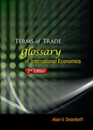
Deardorff’s Glossary of International Economics:
The Terms of Trade and Other Wonders
Intro
Terms, with search
Bibliography
Figures
Lists
Origins

Slide 9
Origins of Selected Terms
I’ll look here (if there’s time) at
CES function
Gravity model
Lerner diagram
Marshall-Lerner condition
Terms of trade
For each I’ll look both at the origin of the idea (the substance) and of the name.

Slide 10
Origins of “CES function”

Slide 11


Origins of “CES function”
Definition
With arguments x = (x₁, … , x_{n} )
where a_{i}, A are positive constants and
is the elasticity of substitution.

Slide 12
Origins of “CES function”
Substance introduced by
Arrow, et al. 1961.
Motive: To "derive a mathematical function having the properties of
(i) homogeneity,
(ii) constant elasticity between capital and labor, and
(iii) the possibility of different elasticities for different industries."

Slide 13


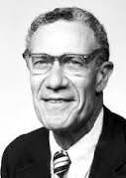
Origins of “CES function”
Arrow, K.J., H.B. Chenery, B.S. Minhas, and R.M. Solow. 1961. "Capital-Labor Substitution and Economic Efficiency," Review of Economics and Statistics 43(3), (August), pp. 225-250.

Slide 14
Origins of “CES function”
Named CES Function by the authors
Other names:
"homohypallagic" function (Minhas 1962)
From Greek: homo = same, hypallage = substitution
"SMAC function” (Mukerji 1963)
Basis of (Spence-)Dixit-Stiglitz utility function, allowing number of goods (varieties) be variable

Slide 15
Origins of “Gravity Model”

Slide 16
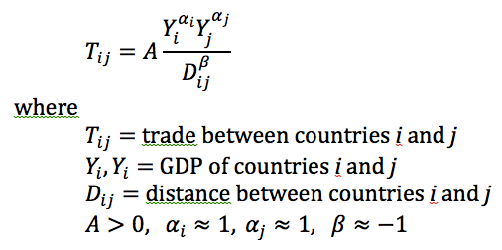
Origins of “Gravity Model”
The standard gravity model of trade:

Slide 17
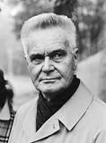
Origins of “Gravity Model”
Substance (but not name) introduced independently by
Tinbergen, Jan. 1962. Shaping the World Economy
A Finnish team that included:
Pöyhönen, Pentti. 1963. "A Tentative Model for the Volume of Trade Between Countries," Weltwirtschaftliches Archiv
Pulliainen, Kyosti. 1963. "A World Trade Study: An Econometric Model of the Pattern of the Commodity Flows in International Trade in 1948-1960," Ekonomiska samfundets tidskrift

Slide 18
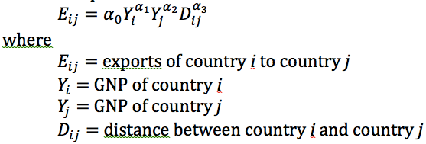
Origins of “Gravity Model”
Tinbergen’s version:
(very much like the basic gravity equation today)

Slide 19
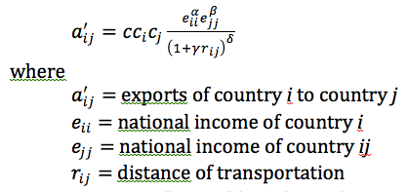
Origins of “Gravity Model”
Pöyhönen’s version:
Differences:
Notation
Country fixed effects
Role of distance

Slide 20
Origins of “Gravity Model”
Naming of the Gravity Model
None of these authors called it this
Tinbergen and Pöyhönen do not use the word gravity or note any analogy with gravitation

Slide 21
Origins of “Gravity Model”
Pulliainen does note the connection with gravity:
“The results of our empirical study show that the structure of international trade is capable of description in terms of gravitational theory. A formal analogy to the theory of gravitation (a=b=1, d=2) is attainable – provided one feels it is desirable…”

Slide 22
Origins of “Gravity Model”
But another early user of the model was Linnemann, Hans. 1966. An Econometric Study of International Trade Flows. But
“Some authors emphasize the analogy with the gravitation law in physics, and try to establish that [α₃=−2]. We fail to see any justification for this.”

Slide 23
Origins of “Gravity Model”
First to call it the Gravity Model: Waelbroeck, J. 1965. "On the Structure of International Trade Interdependence," Cahiers Economiques de Bruxelles

Slide 24
Origins of “Gravity Model”
Waelbroeck
“Hypothesis 2: The gravity model”
“There is, as has been pointed out, an odd similarity between formulae (6) and (7) and the law of gravity, with Y_{i} and Y_{j} playing the role of masses, and this justifies christening the model as the gravity, or G, model.

Slide 25
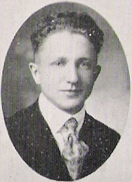
Origins of “Gravity Model”
Earlier origins outside of trade
Substance
Zipf 1946, “The P₁P₂/D Hypothesis” for inter-city movements of freight, persons, information, etc.
Stewart 1947 for “Distribution and Equilibrium of Population,” calling it “potential.”

Slide 26
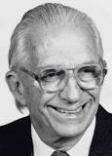
Origins of “Gravity Model”
Earlier origins outside of trade
Name
Bramhall & Isard 1960 on regional science: “gravity, potential, and spacial interaction models -- which for short we shall term gravity models.”

Slide 27
Origins of “Lerner diagram”

Slide 28
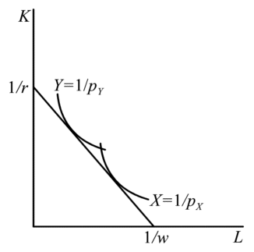
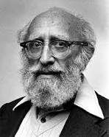
Origins of “Lerner diagram”
Diagram:

Slide 29
Origins of “Lerner diagram”
Diagram was first published in Lerner, Abba P. 1952. "Factor Prices and International Trade," Economica
But Lerner first drew it in an unpublished seminar paper in 1933.
That paper was reproduced in 1952 “as it was originally written,” according to the journal editor.

Slide 30
Origins of “Lerner diagram”
First noticed in print in Findlay and Grubert. 1959. They cited Lerner, but never called it the “Lerner diagram.”

Slide 31


Origins of “Lerner diagram”
Findlay, Ronald and Harry Grubert. 1959. "Factor Intensities, Technological Progress and the Terms of Trade," Oxford Economic Papers

Slide 32
Origins of “Lerner diagram”
First to call it the “Lerner diagram” was Findlay 1971.
Findlay, Ronald. 1971. "Comparative Advantage, Effective Protection and the Domestic Resource Cost of Foreign Exchange," Journal of International Economics

Slide 33
Origins of “Lerner diagram”
Others – apparently before Findlay 1971 -- have called it the “Lerner-Pearce diagram,” due to Pearce, Ivor F. 1952. "The Factor Price Equalization Myth," Review of Economic Studies
That uses unit isoquants, not unit-value isoquants, and thus cannot do what the true Lerner diagram is able to.

Slide 34
Origins of “Marshall-Lerner Condition”

Slide 35
Origins of “Marshall-Lerner Condition”
The condition:
η_{X} + η_{M} > 1
η_{X}, η_{M} are the demand elasticities for a country's exports and imports
Condition for
Stability of international exchange of goods
Devaluation to improve the trade balance
Stability of the market for foreign exchange

Slide 36

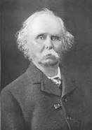
Origins of “Marshall-Lerner Condition”
Substance
Marshall, Alfred. 1923. Money, Credit and Commerce
In the context of offer-curve stability (of international exchange of goods)
“elasticity of demand of each country…be on average to be less than one half.”
had done much of the work between 1869 and 1873, privately printed & circulated in 1879.
[So he published 50 years later. Wow!]

Slide 37
Origins of “Marshall-Lerner Condition”
Substance
Lerner, Abba P. 1944. The Economics of Control: Principles of Welfare Economics
Context: Stability of full employment in Keynesian model where net exports are part of aggregate demand.
Thus, will fall in prices (or currency depreciation) cause net exports to rise or fall?
“The critical point is where the sum of the elasticity of demand for imports plus the elasticity of demand for exports is equal to unity.”

Slide 38
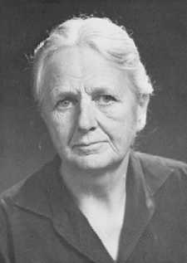
Origins of “Marshall-Lerner Condition”
Substance
Robinson?
Robinson, Joan. 1937. Essays in the Theory of Employment
Same question as Lerner, but her answer was:
k{[ε_{f}(1+η_{h})/(ε_{f}+η_{h})] − Ip[η_{f}(1−ε_{h})/(η_{f}+ε_{h})]} > 0
(Notation is different. ε_{f ,}ε_{h} are the demand elasticities.)
This becomes the M-L condition with balanced trade and infinite supply elasticities, but Robinson didn’t mention this until her 1947 revision.
So no.

Slide 39
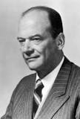
Origins of “Marshall-Lerner Condition”
Name
Condition was cited by others – Polak (1947), Haberler (1949) – but not by that name.
Polak: “the well-known formula”
Haberler: “Lerner condition” (although he acknowledged both Marshall and Robinson)

Slide 40
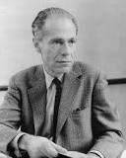
Origins of “Marshall-Lerner Condition”
Name: First was
Hirschman, Albert O. 1949. "Devaluation and the Trade Balance: A Note," Review of Economics and Statistics
His point was the M-L is wrong for improving a non-zero trade balance:
“Our results permit the following conclusions:
(a) The "Marshall-Lerner" condition for devaluation to have a favorable effect on the trade balance (sum of the two elasticities larger than unity) holds only when imports are equal to exports.”

Slide 41
Origins of “Terms of Trade”

Slide 42
Origins of “Terms of Trade”
Definition
The relative price, on world markets, of a country’s exports compared to its imports
Most commonly, if
P_{x} = price of exports
P_{m} = price of imports
Then
TT = P_{x}/P_{m}

Slide 43
Origins of “Terms of Trade”
Substance and Name
Marshall, Alfred. 1923. Money, Credit and Commerce
(For countries E and G,)
“the amounts to which E and G would be severally willing to trade at various 'terms of trade'; or, to use a phrase which is more appropriate in some connections, at various 'rates of exchange.”

Slide 44
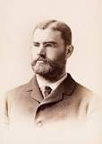
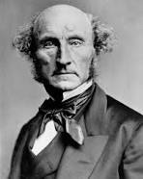
Origins of “Terms of Trade”
Was Marshall the first?
Taussig (1927) says so.
Mill (1848) did not use the phrase
I’ve not checked all in between

Slide 45
Origins of “Terms of Trade”
Alternative (or more precise) definitions
Taussig (1927)
Preferred the term “barter terms of trade”
Also defined
“Net barter terms of trade”
“Gross barter terms of trade”
(Differ if trade is not balanced.)

Slide 46
Origins of “Terms of Trade”
“Net barter terms of trade”
NBTT = P_{x}/P_{m}
P_{x} = price of exports
P_{m} = price of imports
“Gross barter terms of trade”
GBTT = Q_{m}/Q_{x}
Q_{x} = quantity of exports
Q_{m} = quantity of imports

Slide 47
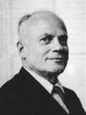
Origins of “Terms of Trade”
Alternative (or more precise) definitions
Viner (1937) said classical economists cared about exchange of factors, as well as goods
Thus defined
Single factoral terms of trade
Double factoral terms of trade

Slide 48
Origins of “Terms of Trade”
“Single factoral terms of trade”
SFTT = NBTT×A_{x} = (P_{x}/P_{m})×A_{x}
A_{x} = own factor productivity producing exports
“Double factoral terms of trade”
DFTT = NBTT×A_{x/}A_{m} (P_{x}/P_{m})×(A_{x/}A_{m})
A_{x} = foreign factor productivity producing imports

Slide 49

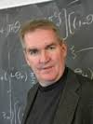

Origins of “Terms of Trade”
And in international finance (?)
Backus, David K., Patrick J. Kehoe, and Finn E. Kydland. 1994. "Dynamics of the Trade Balance and the Terms of Trade: The J-Curve?" American Economic Review
“The terms of trade, in this paper, is the relative price of imports to exports…”

